Slide 1
Final Year Project
Nouman Zafar

Slide 2
Movies Review
Welcome to my movie review website. This website will provide valuable insights, ratings, and recommendations for both new and classic films. Website will cover wide range of genre and provide detailed review of each movie.
User of this website will be able to see the poster, cast & crew, trailer, ratings and reviews from multiple users for a movie.

Slide 3
Parts of the Project
There are 3 parts of the project
1. Front End
2. Back End
3. Database

Slide 4
Technologies
Front End: For this part of the project Angular framework will be used
Back End: For this I am going to use Java Spring boot along with Speedment.
Storage: MySQL will be used to store the data. And it will be deployed on AWS.

Slide 5
Architecture
This project will have full stack architecture incorporating Database, Server and Browser where server of the project will be used to feed the information to angular. Front end will consume the information from server and produce a web page displaying all that information appropriately.

Slide 6
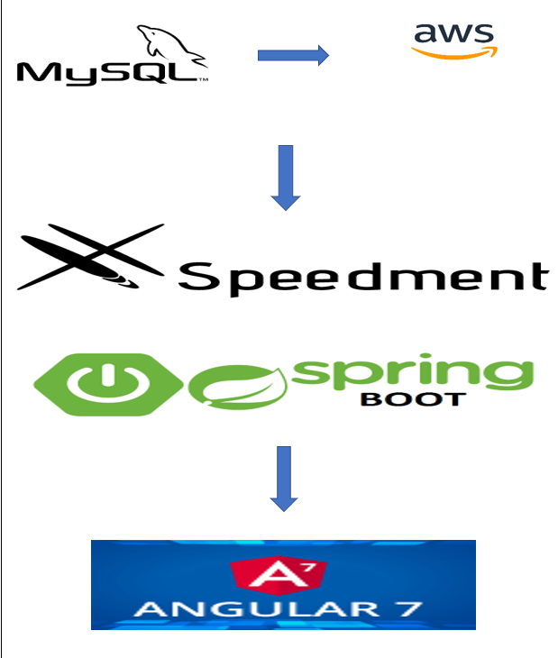
Architecture

Slide 7


